Slide 1
Intuitive and Interactive Query Formulation to Improve the Usability of Query Systems for Heterogeneous Graphs
Nandish Jayaram
University of Texas at Arlington
PhD Advisors: Dr. Chengkai Li, Dr. Ramez Elmasri
VLDB 2015 Phd Workshop
August 31st 2015

Slide 2
Outline
Motivation: Graph Data Usability
Visual Interface for Recommendation Based Interactive Graph Query Formulation (Orion)
Graph Query By Example (GQBE)
2

Slide 3
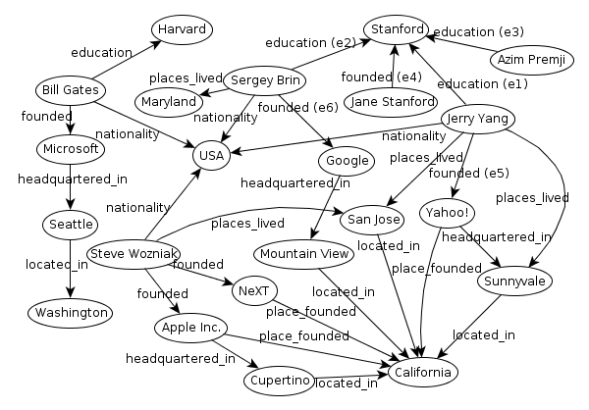
Large Heterogeneous Graphs
Large, complex and schema-less graphs capturing millions of entities and relationships between them!
Entity
Relationship
Linking Open Data : 52 billion RDF triples
Freebase : 1.8 billion triples
DBpedia : 470 million triples
Yago : 120 million triples
3

Slide 4
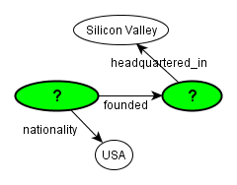
Specifying Queries for Graphs
SQL QUERY:
SELECT Founder.subj, Founder.obj
FROM Founder, Nationality, HeadquarteredIn
WHERE
Founder.property = ‘founded’ AND
Founder.subj = Nationality.subj AND
Nationality.property = ‘nationality’ AND
Founder.obj = HeadquarteredIn.subj AND
HeadquarteredIn.property = ‘headquartered_in’;
SPARQL QUERY:
SELECT ?company ?founder WHERE {
:?founder dbo:founded :?company .
:?founder dbo:nationality :USA .
:?company dbprop:headquartered_in :Silicon Valley .
}
4

Slide 5
Simpler Querying Paradigms
Keyword Search
Keyword search in Graphs [Kargar, VLDB’11], BLINKS [He, SIGMOD’07]
Limitation: Articulating keyword query for graphs is not simple
Approximate Query Specification and Answering
NESS: uses neighborhood-based indexes to quickly find approximate matches to a query graph [Khan, SIGMOD’11]
TALE: approximate large graph matching [Tian, ICDE’08]
Limitation: Users still have to formulate the initial query graph
5

Slide 6
Visual Query Formulation Systems
Relational Databases
CLIDE [Petropoulos, SIGMOD’06,07]
Graph Databases
VOGUE, PRAGUE, Gblender, [Bhowmick, CIDR’13, ICDE’12, SIGMOD’11], GRAPHITE [Chau, ICDMW’08]
Single Large Graphs
QUBLE [Bhowmick, VLDB’14]
Limitations:
New relevant query components are not automatically recommended to users
Users require a good knowledge of the underlying schema
6

Slide 7
Desiderata of a User Friendly Query System
Usability
An easy-to-use graphical interface for formulating query graphs
Easier paradigm to query complex heterogeneous graphs
Ability to express exact query intent
Schema agnostic users assisted by an intelligent query system
7

Slide 8
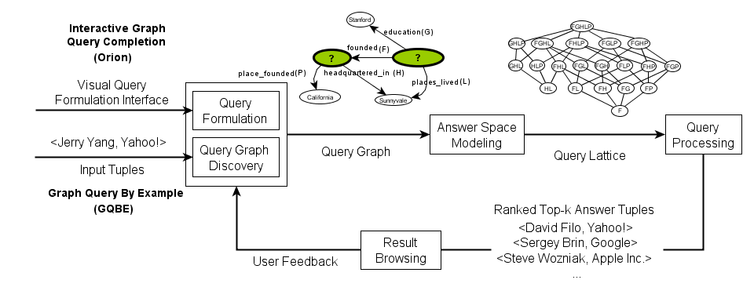
Dissertation Research Outline
Possible Future Work
8

Slide 9
Visual Interface for Recommendation Based Interactive Query Formulation (Orion)
Ongoing work
9

Slide 10
Problem Statement
Given a large heterogeneous graph, iteratively suggest edges to help build a query graph
An interactive graphical user interface for building query components
An edge recommendation system that ranks edges based on their relevance to the user’s query intent
10

Slide 11
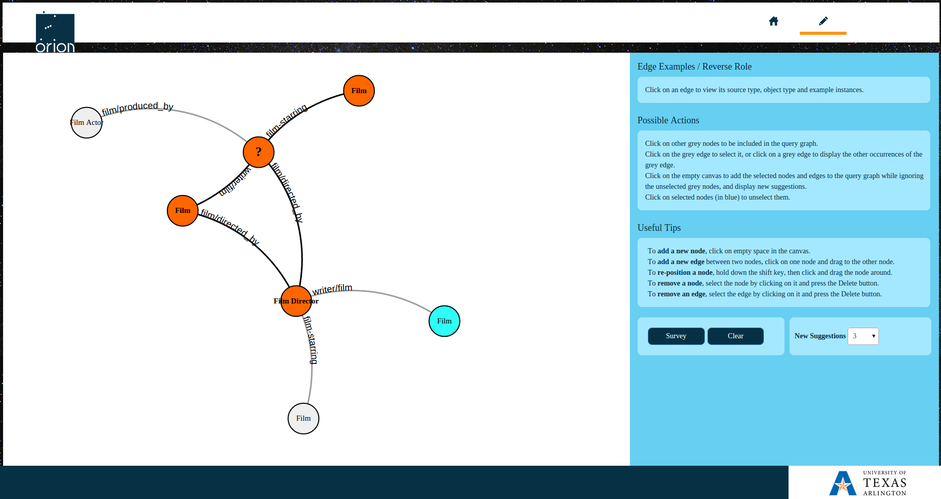
Orion Interface (idir.uta.edu/orion)
Query Canvas
Dynamic help indicating possible actions at every moment
Useful tips for basic operations
Information Panel
11

Slide 12
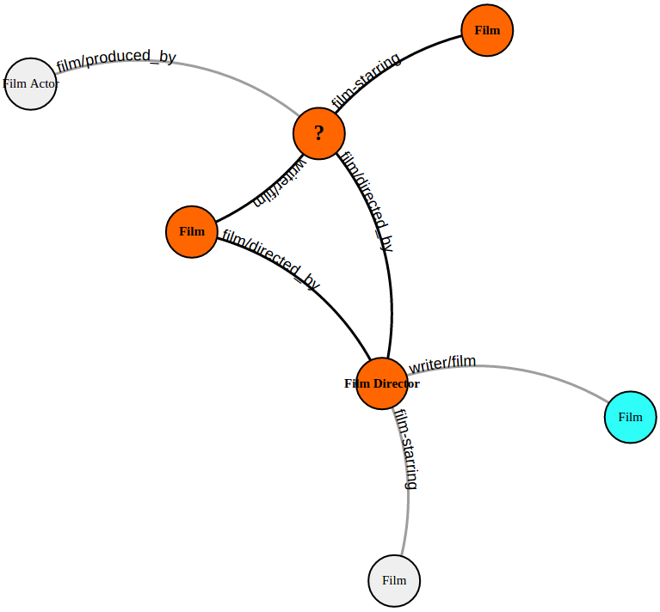
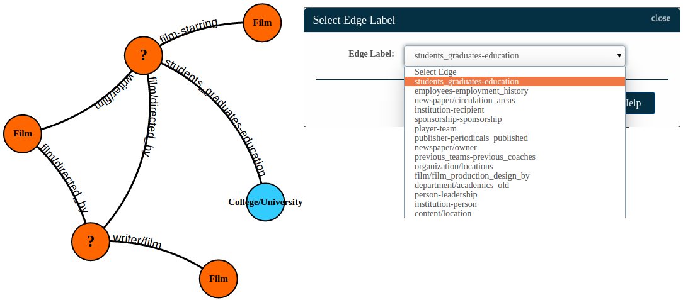
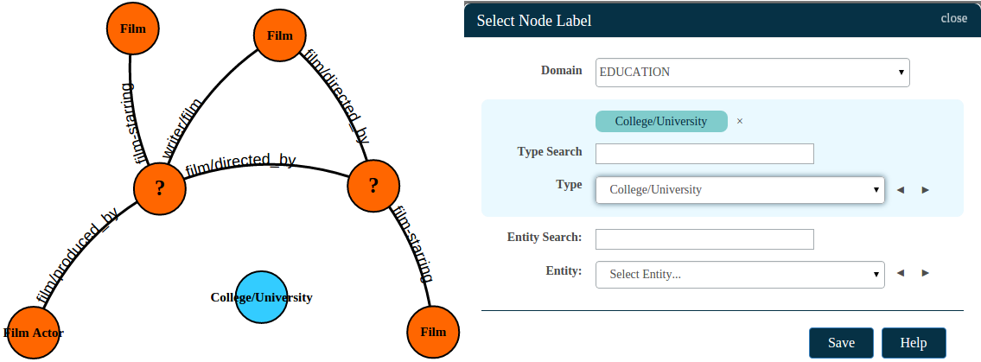
Modes of Operation: Passive and Active
Grey edges and nodes automatically suggested in passive mode
Suggested edges accepted by the user (with blue node) are positive edges. Grey edges ignored are negative edges.
A suggested edge accepted by the user
A new node added in active mode
A new edge added in active mode
12

Slide 13
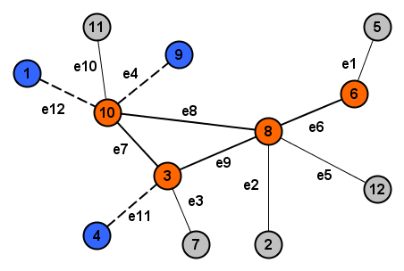
Preliminaries
Edges in partial query graph (positive edges)
e6, e7, e8, e9
Edges rejected by users (negative edges)
e4, e11, e12
Candidate edges
e1, e2, e3, e5, e10
Query Session:
<(e6,yes), (e7,yes), (e8,yes), (e9,yes), (e4,no), (e11,no), (e12,no)>
represented as
(e6, e7, e8, e9, -e4, -e11, -e12)
13

Slide 14
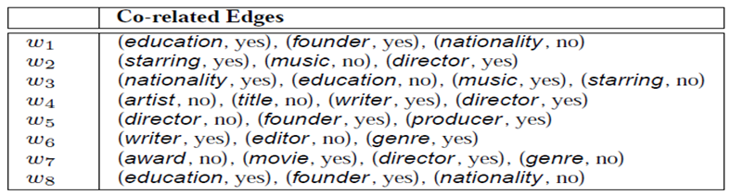
Query Log
Collection of several user sessions
Session Id
14

Slide 15
Algorithms to Rank Candidate Edges
Possible Solutions
Order alphabetically
Use standard machine learning methods
Recommendation system
Association rule mining based classification
Classification: naïve Bayesian classifier, random forests
Query-specific random correlation paths based suggestion
15

Slide 16
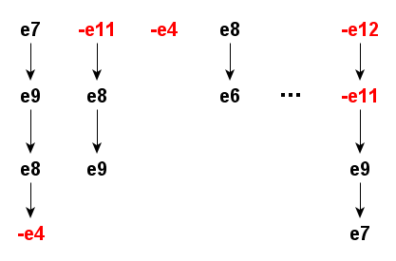
Random Correlation Paths (RCPs) Based Ranking
Choose edges from the query session randomly to form RCPs:
Grow a path incrementally until its support in the query log drops below a threshold (t).
For each RCP, use its corresponding query log subset to compute support for each candidate edge.
Each correlation path selects a subset of the query log, with no more than ‘t’ rows in it
Session Id
Final score of each candidate is its average score across all RCPs.
16

Slide 17
Preliminary Results
Target Query Graphs |  |  | Edge Ranking Algorithms
Query Graph | # of edges |  | RCP | RCP (no negative edges) | Random Forest Classifier | Random
ForrestGump-directorType | 3 |  | 12 | 11 | >100 | 37
FilmType-directorType | 5 |  | 39 | >100 | 41 | >100
DirectorType-actorType | 3 |  | >100 | >100 | >100 | >100
FilmType-DirectorType | 4 |  | 28 | >100 | 31 | >100
FilmType-DirectorType | 3 |  | 14 | 27 | 25 | >100
FounderType-SchoolType | 5 |  | 34 | >100 | 33 | >100
FounderType-SchoolType | 4 |  | >100 | >100 | >100 | >100
JerryYang-SchoolType | 5 |  | 34 | 85 | >100 | >100
JerryYang-Yahoo-Stanford | 4 |  | 14 | >100 | 33 | >100
17

Slide 18
Evaluation Plan for Orion
Compare with other standard machine learning algorithms
User studies to gauge the effectiveness of our system and compare with naïve approaches like listing suggestions alphabetically
Study effectiveness (number of suggestions required) using several simulated target query graphs
Experiments with other datasets (DBpedia, YAGO)
Publication
VIIQ: Auto-suggestion Enabled Visual Interface for Interactive Query Formulation, Nandish Jayaram, Sidharth Goyal, Chengkai Li, VLDB 2015, Demonstration description
18

Slide 19
Graph Query By Example (GQBE)
19

Slide 20
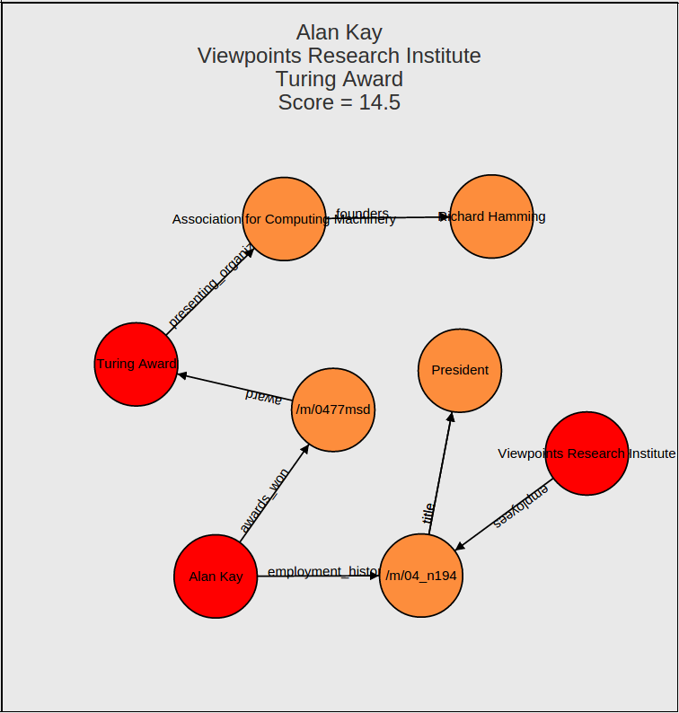
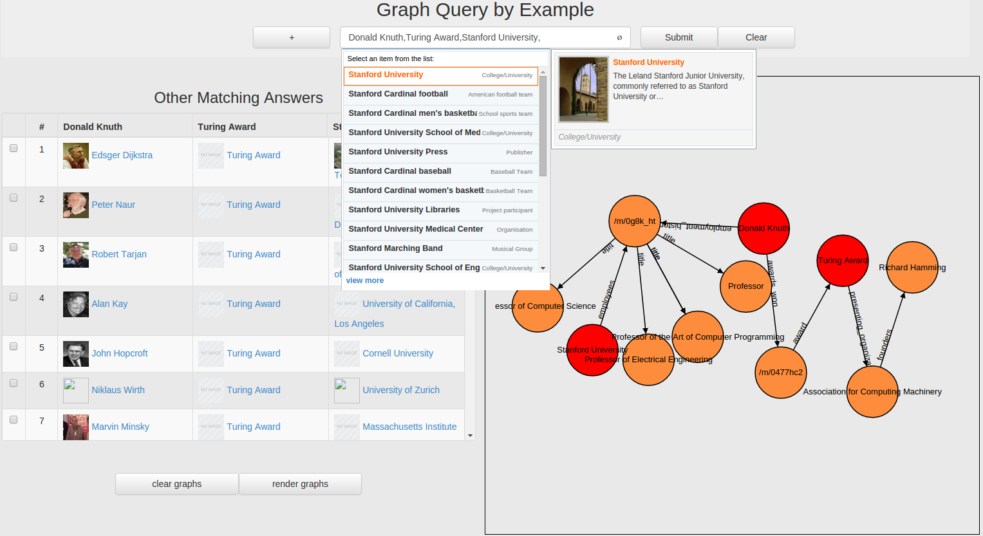
GQBE Interface (idir.uta.edu/gqbe)
Ranked similar answer tuples
Query graph automatically discovered by the system
Keyword completion powered query interface
Maximum Query Graph
An example answer graph
20

Slide 21
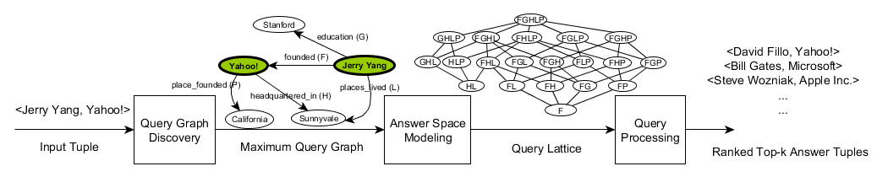
Challenges
21

Slide 22
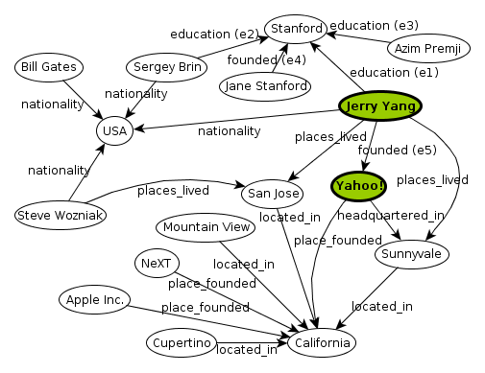
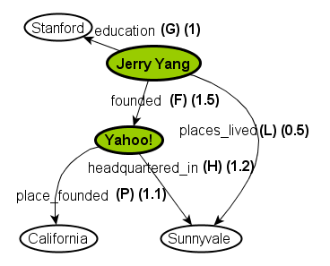
Query Graph Discovery
Neighborhood Graph Query Graph
22

Slide 23
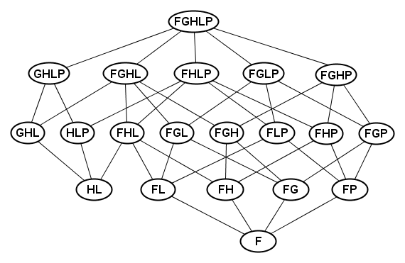
Query Processing
Every other node is a sub-graph of the MQG.
Maximum Query Graph (MQG)
Minimal Query Trees
23

Slide 24
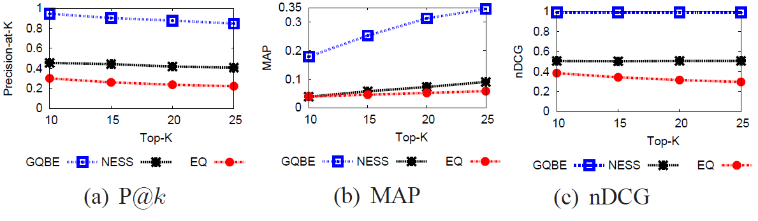
Experiments: Accuracy Comparison with NESS and EQ
Dataset:
Freebase (47 million edges, 27 million nodes, 5.4 K edge labels)
24

Slide 25
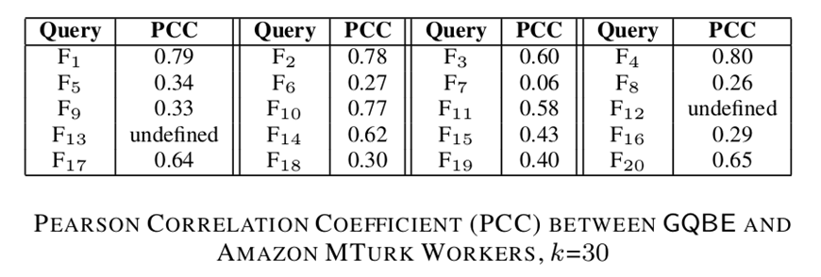
Experiments: User Study with Amazon MTurk
[0.5, 1.0] : Strong positive correlation
[0.3, 0.5) : Medium positive correlation
[0.1, 0.3) : Small positive correlation
25

Slide 26
Publications
Querying Knowledge Graphs by Example Entity Tuples, Nandish Jayaram, Arijit Khan, Chengkai Li, Xifeng Yan, Ramez Elmasri, TKDE (to appear)
GQBE: Querying Knowledge Graphs by Example Entity Tuples, Nandish Jayaram, Mahesh Gupta, Arijit Khan, Chengkai Li, Xifeng Yan, Ramez Elmasri, ICDE’ 14, Demonstration description
Towards a Query-by-Example System for Knowledge Graphs, Nandish Jayaram, Arijit Khan, Chengkai Li, Xifeng Yan, Ramez Elmasri, GRADES’ 14
26

Slide 27
Orion Demonstration at VLDB 2015
Demo Session 3 (Kona 4)
VIIQ: Auto-Suggestion Enabled Visual Interface for Interactive Graph Query Formulation
September 3rd, Wednesday (10:30 am to 12:00 pm)
September 4th, Thursday (3:30 pm to 5:00 pm)
27

Slide 28
Thank You!
nandish.jayaram@mavs.uta.edu
https://sites.google.com/site/jnandish

Slide 29
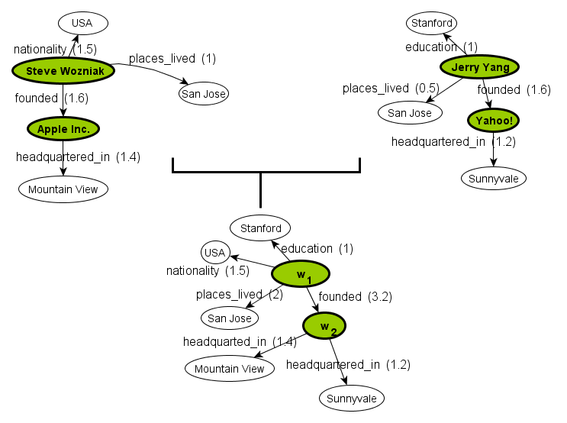
Multiple Example Tuples
24

Slide 30
Experiments: Efficiency Results
Single Query Execution Times (in seconds)
27

Slide 31
Future Work
27

Slide 32
Future Work
Comprehensive experiments and evaluation of Orion
Evaluate the partial query graph at every iteration of the query formulation process in Orion
User feedback loop after browsing the results
28

Slide 33
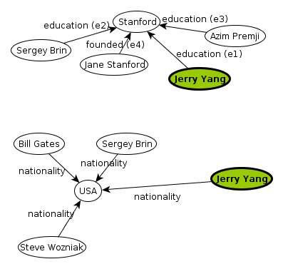
Cleaning Neighborhood Graph
- Neighborhood graphs can be large even for a small d; hundreds of thousands of edges and vertices!
- Clean some clearly unimportant edges.

Slide 34
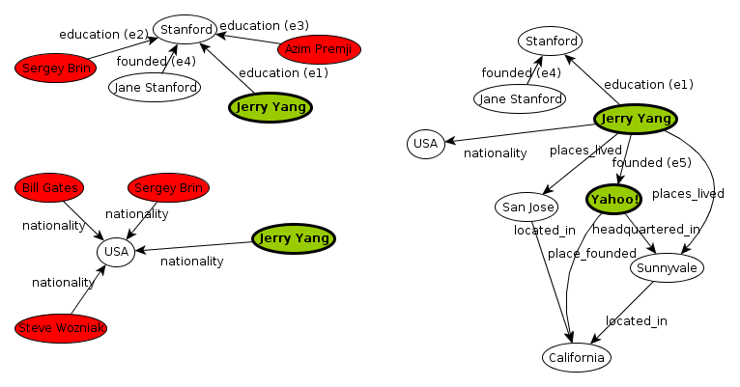
Reduced Neighborhood Graph

Slide 35
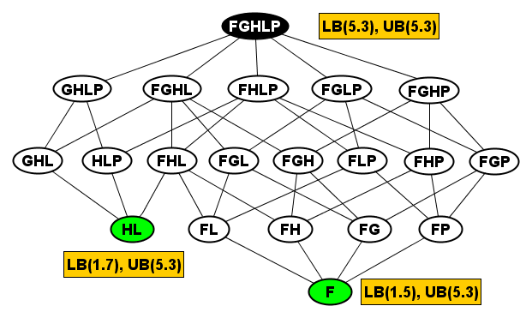
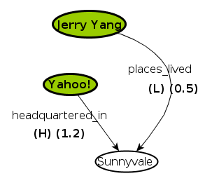
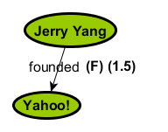
Query Processing
21

Slide 36
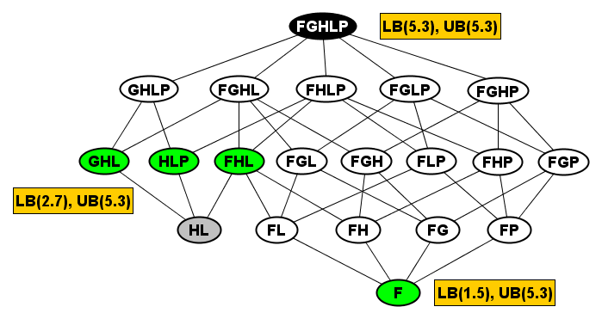
Query Processing (cont.)
22

Slide 37
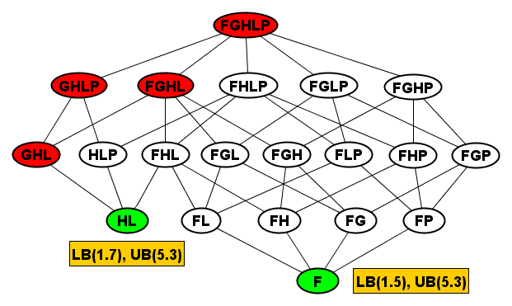
Query Processing (cont.)
23

Slide 38
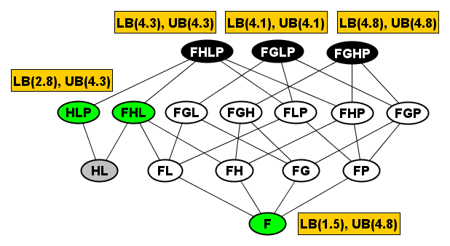
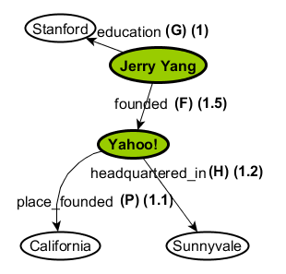
Query Processing (cont.)
24

Slide 39
Evaluation Plan for Orion (cont.)
Study effectiveness (number of suggestions required) using simulated target query graphs
Experiments with other datasets (DBpedia, YAGO)
Experiments to study effectiveness of simulated query log
52

